Slide 1
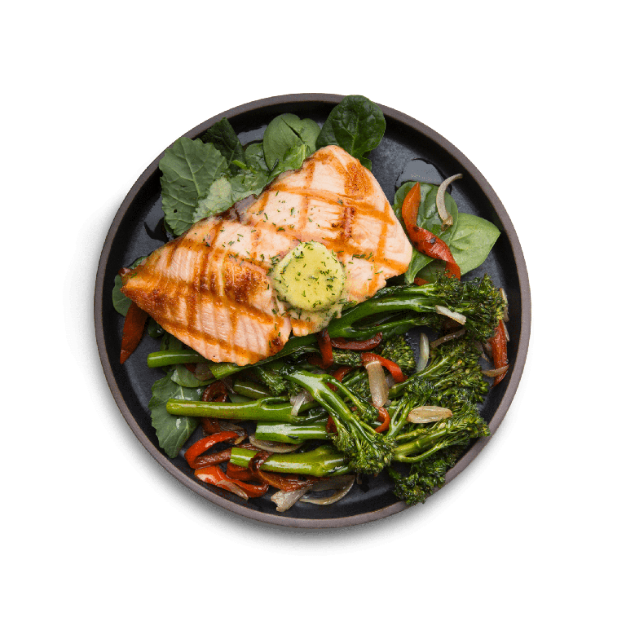
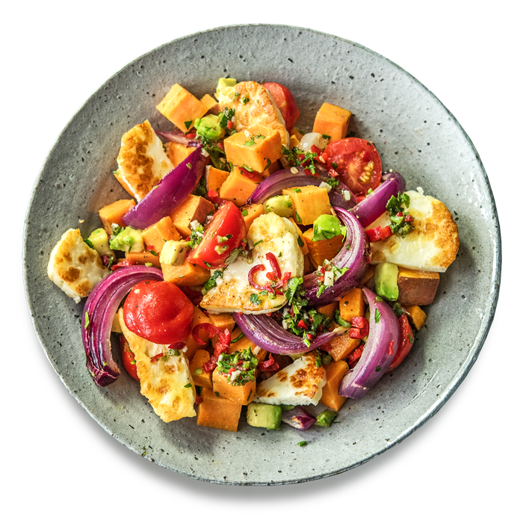
HA
BIG PLATE

Slide 2
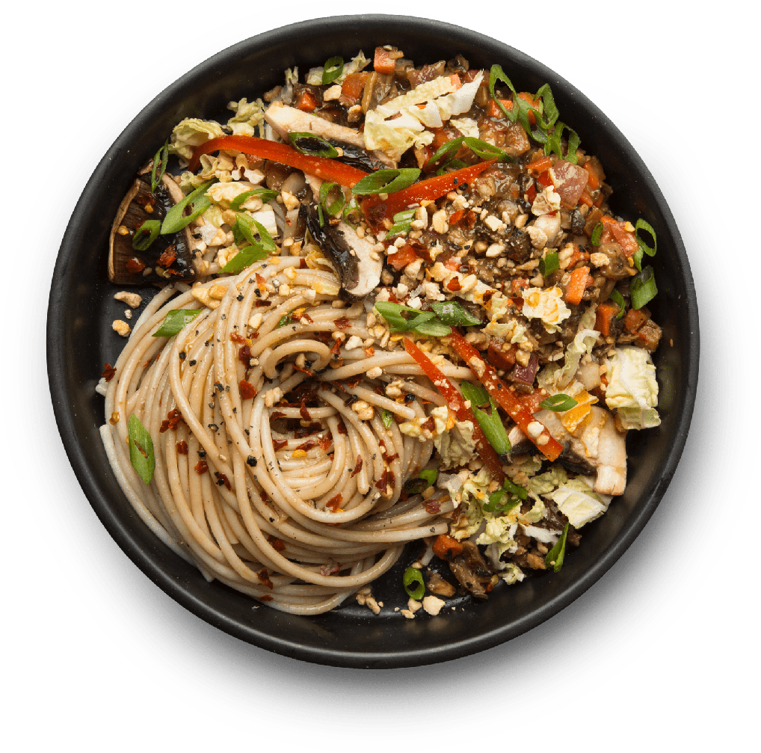
BIG PLATE
meggie
B u t C u r s i v e

Slide 3


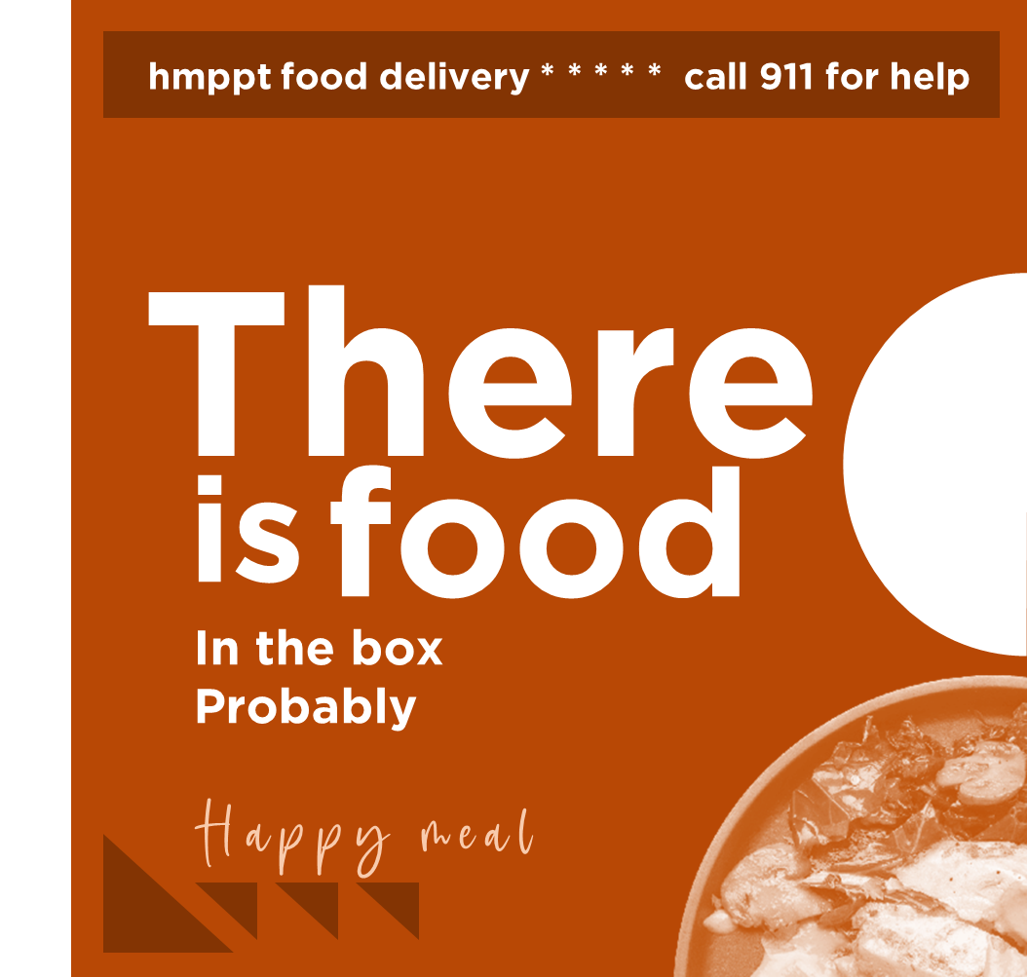
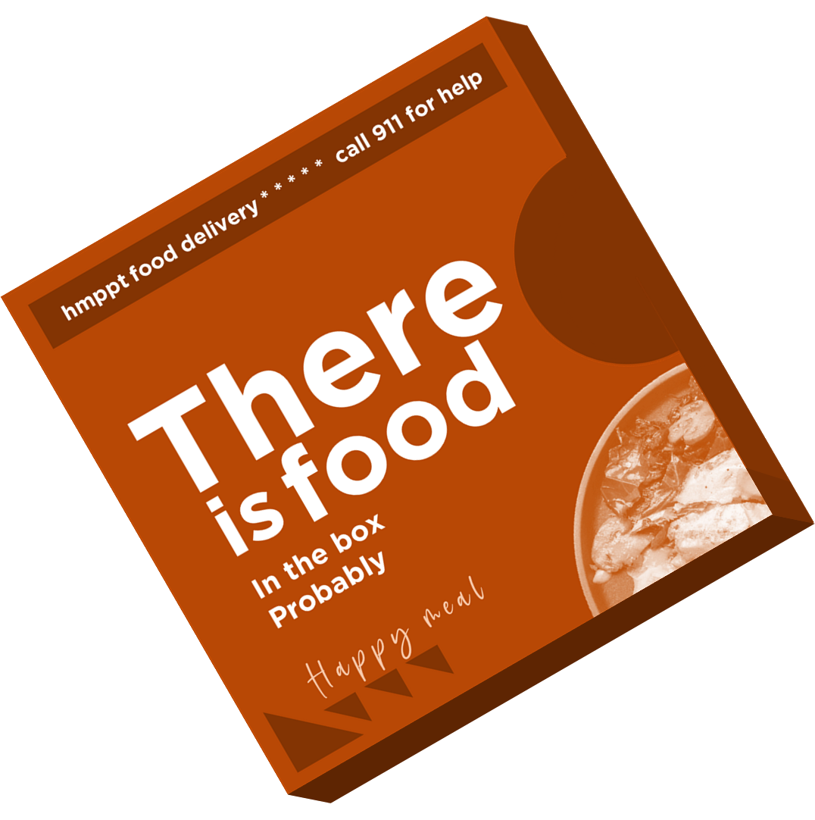
meggie
B u t C u r s i v e
Scrumptious
Ah fancy gituh
Spicy
Icy
cookie

Slide 4
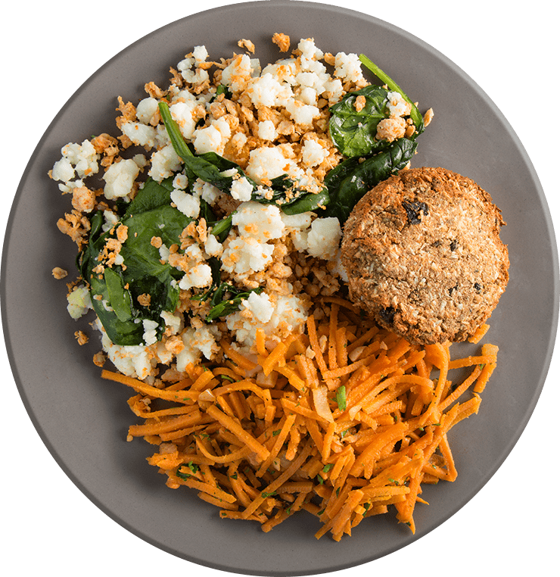
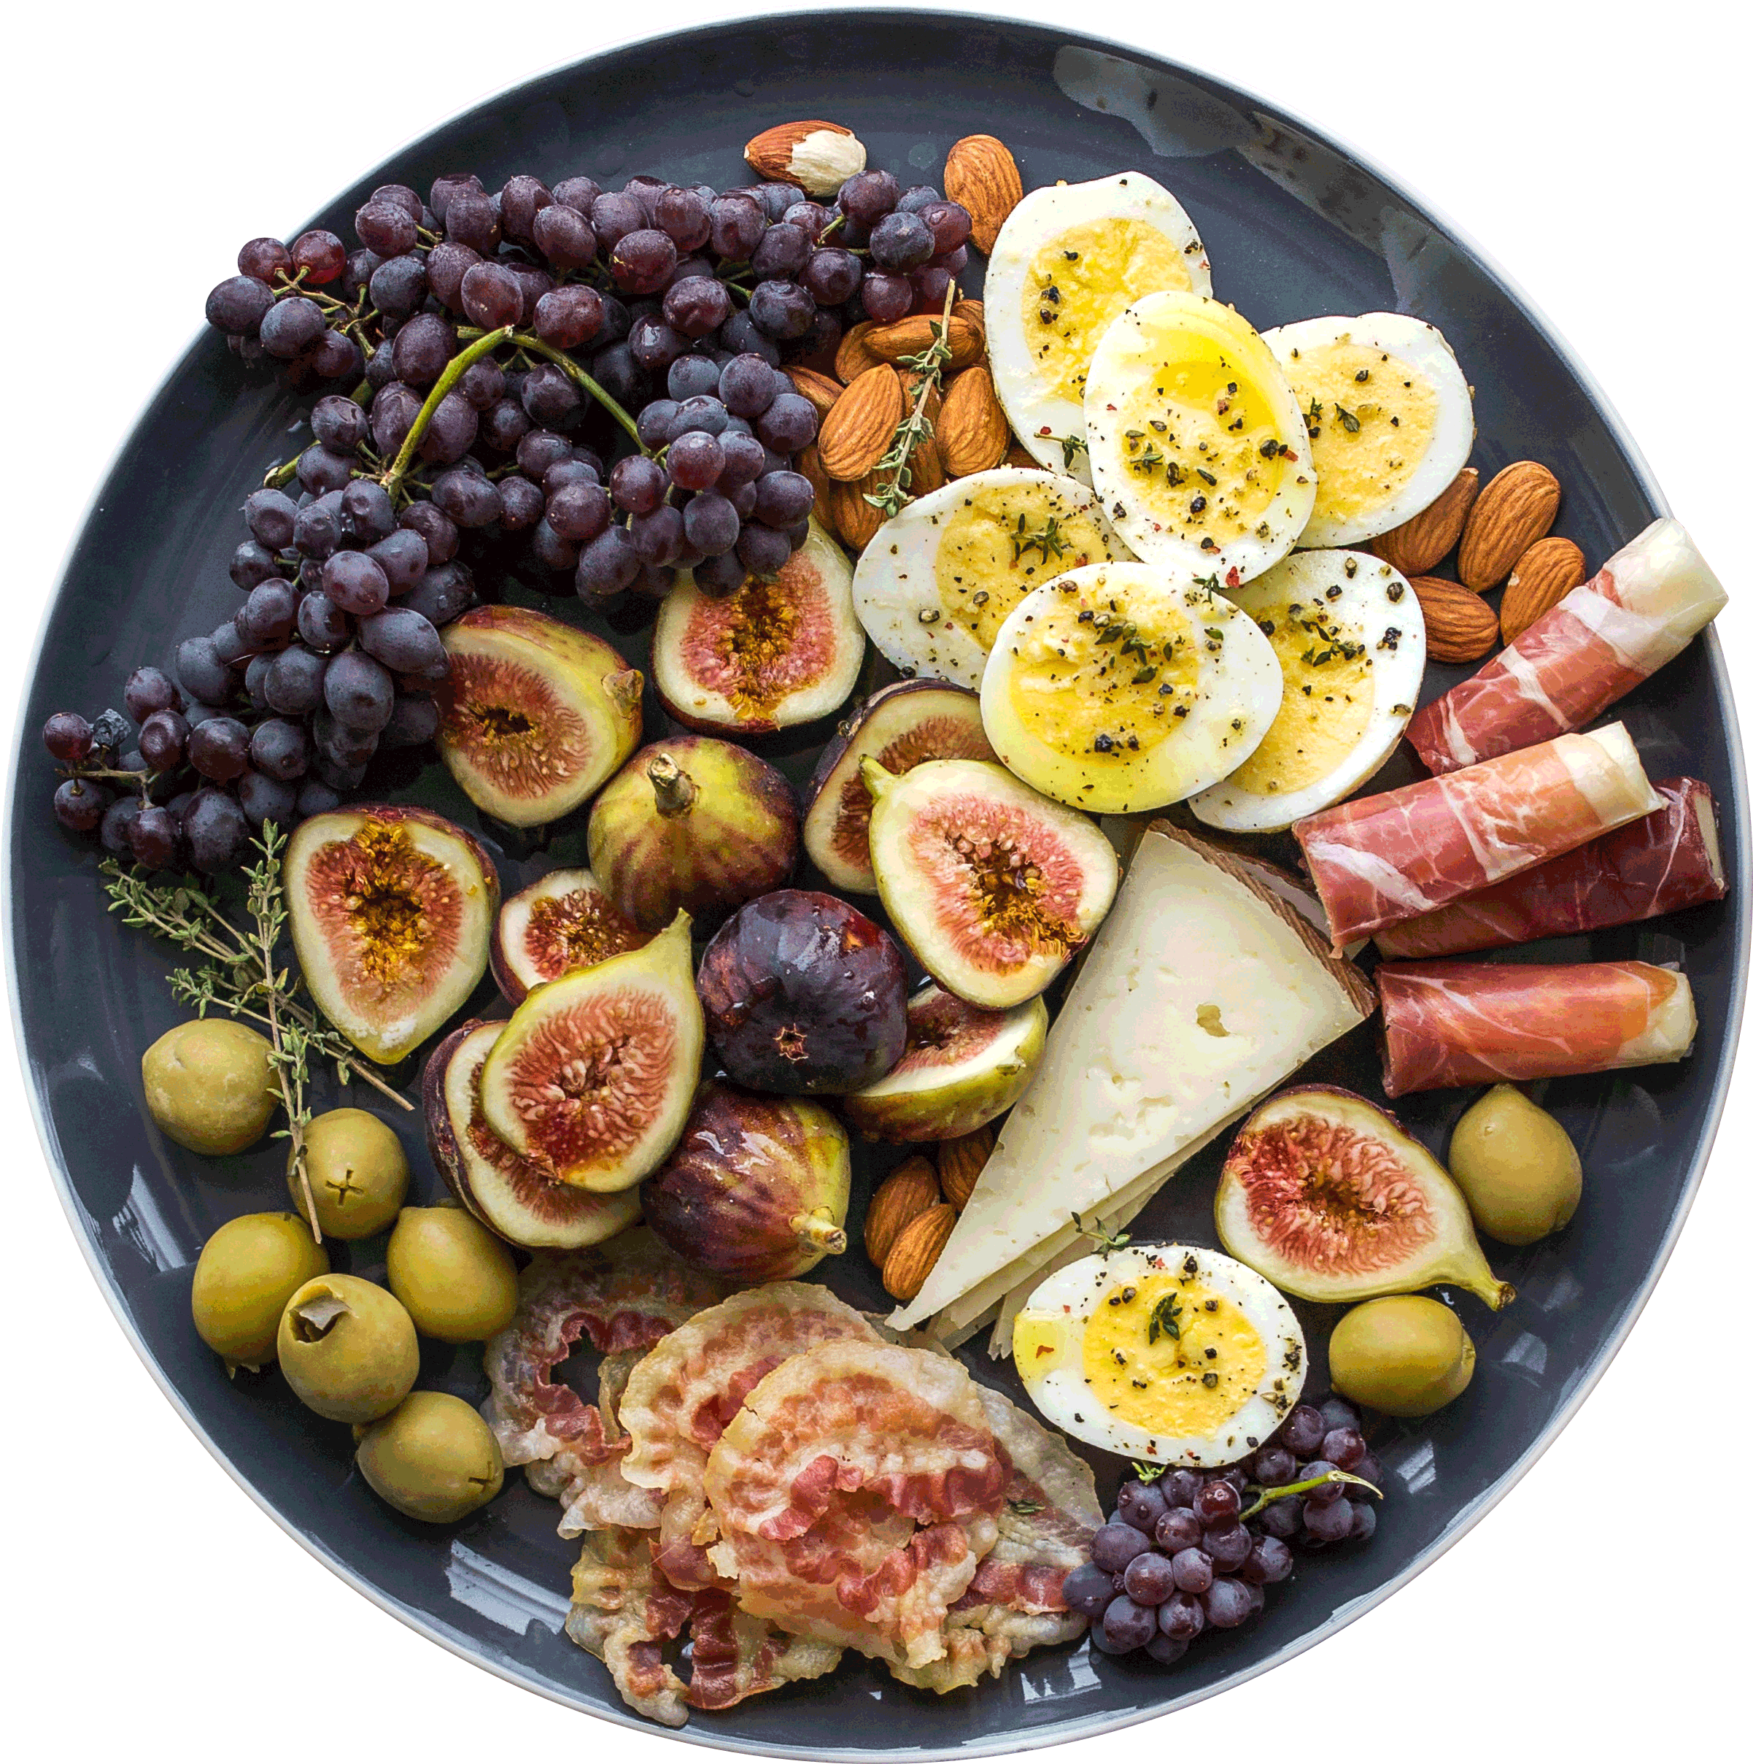
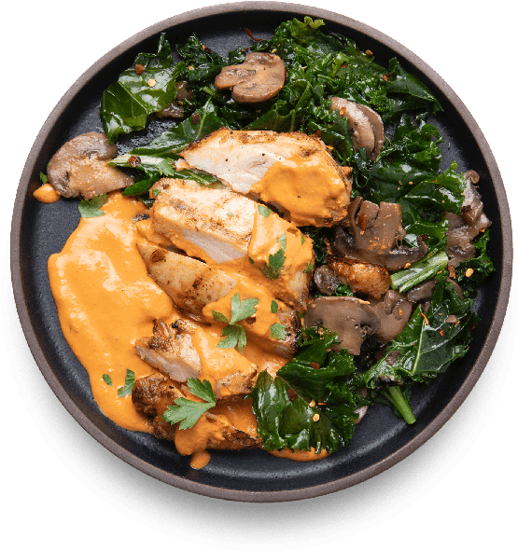
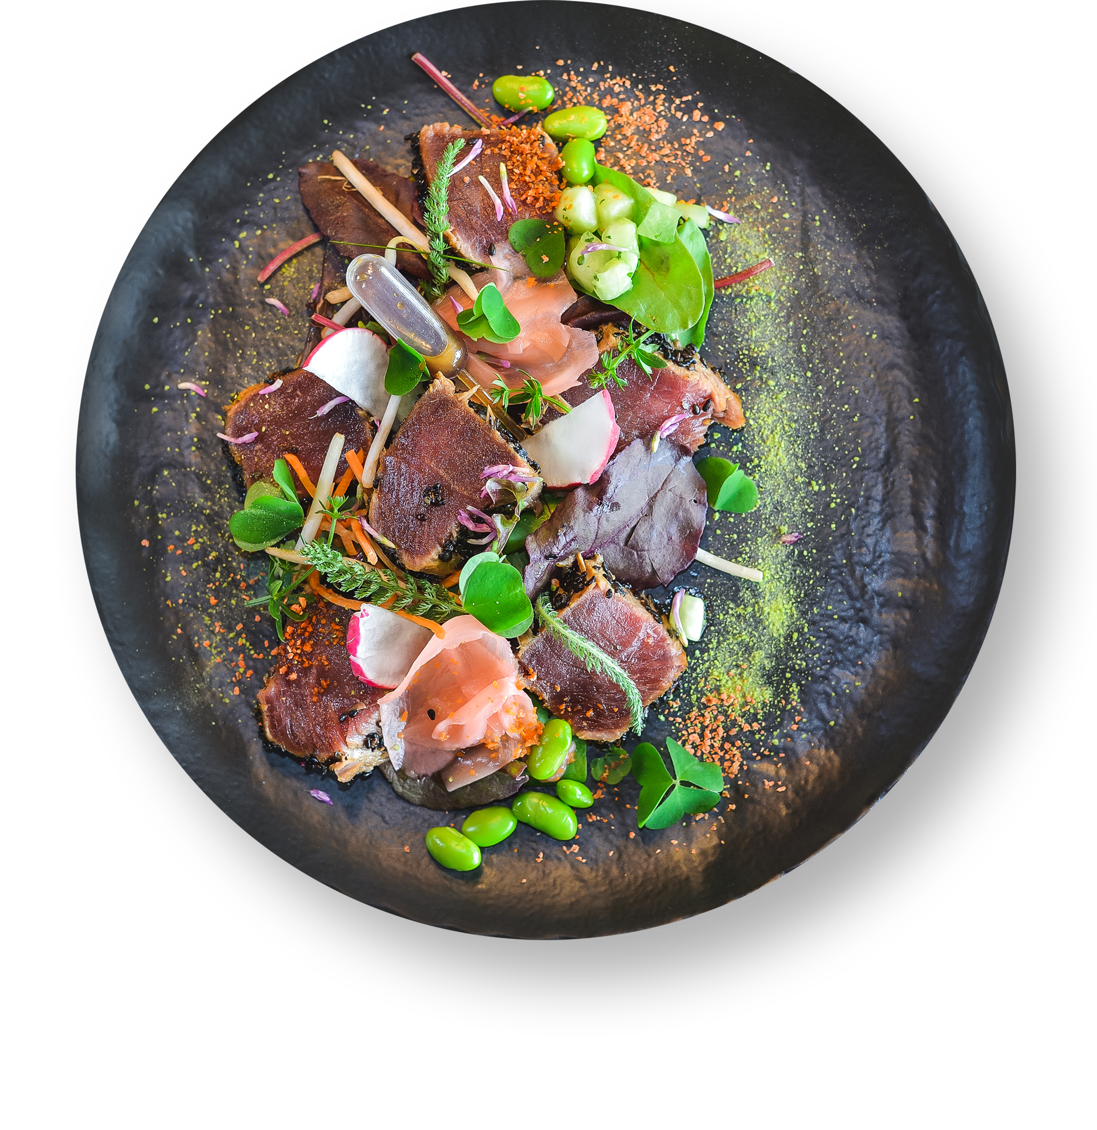
Search for food
HA
VARIOUS
FOOD
OF
Food is usually something we can eat, like ikan masin
SELECTION
Scrumptious
Ah fancy gituh
Spicy
Icy
cookie

Slide 5
Search for food
VARIOUS
OF
hmppt
SELECTION
FOOD
Food is usually something we can eat, like ikan masin
Scrumptious
Ah fancy gituh
Devours
Spicy
Everything
Like
Icy
A racoon
cookie
Long live racoon eater

Slide 6
Search for food
HA
VARIOUS
OF
SELECTION
FOOD
Food is usually something we can eat, like ikan masin
Devours
Like
Everything
A racoon
Long live racoon eater

Slide 7


